Slide 1
Ad Hoc Facilities Committee Recommendation

Slide 2
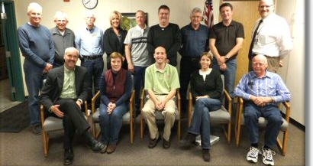
The Ad Hoc Committee Members
Standing, from left: Bill Woodard, Jerry Huston, Noel Johnson, Tina Cayton, Luke Miller, Randy Sorensen, Paul Cline, Nick Massie, Michael Green.
Seated, from left: John Shoup, Ellie Gillaspie, Ben Fredricks, Nancy Trevina, Don Stuart.

Slide 3
Scope Recommendation
Construct 130,000 s.f. High School Building
  Open for 850-900 students
  Build Core for 1100-1200 students
Build what we NEED, not what we want
  Upgrade rather than replace current Auditorium and Beaver Stadium
  Plan new site for future expansion
Update/upgrade current facilities
  WIS/WMS/WHS upgraded to accommodate transition of younger students
  Remodel Replace aging multi-purpose gym at Yale

Slide 4
Timing & Process Recommendation
GET SERIOUS about what we are building… Select and architect and have a clear plan for voters.
  Hire an Architect by January 9th
  Hire a planning consultant NOW to do preliminary design and budget work.
Present the bond request to voters for April 17 election.
  February date desirable BUT will constrain ability to get good information to voters.
  April will allow for a quality information to be developed and communicated.

Slide 5
Estimated Bond Request
Construction Costs (includes construction costs, development costs, premiums for wetlands, and off-site costs) | $ 47,523,302
Estimated State Assistance (“State Match”) | $ 11,000,000
Local Share | $ 36,523,302
Other District-wide projects, contingency, and inflation allowance | $ 3,338,083
Total: | $ 39,861,385
Total Recommended Bond Request | $ 39,875,000
This budget is preliminary and may be adjusted as the consultant reviews the projects more closely.

Slide 6
Proposed Bond Structure

Slide 7
Proposed bond structure

